Slide 1
A Seminar on Fake Product Identification using Blockchain
Team Details :
B.SATHVIK(20EG105403)
G.SANDEEP(20EG105413)
V.SRAVAN(20EG105449)
Project Supervisor
Name : JAYENDRA KUMAR
Designation : ASST PROFESSOR

Slide 2
Introduction
The increasing in fake goods is severely affecting the industrial sector and consumers.
According to the survey, incidences involving fake products have increased in recent years, which have had a negative impact on scales, profits and brand recognition.
Far from reducing the ability of a company to make money, this counterfeiting also effects the consumers ability to trust their goods in open market.
Without proper tracking and security measures, consumers gradually stop trusting brands to keep their consumers safe from theft. This is happening because the manufacturing and distribution processes are hidden to consumers and this information is easily manipulated or falsified by others. So users must have a method to determine if a product is genuine or not.

Slide 3
Problem Statement
The Costumers and the users want to determine the product genuine or not.
By a decentralized Blockchain technology for product identification and counterfeit protection, the suggested system makes use of a blockchain-based platform.
Product authentication, counterfeit prevention, traceability, and data analysis, This unique identity can be linked with the product details and it becomes very easy for tracing back the originality of the product.
By these way tracking the fake product the costumers can know which product is genuine or not.

Slide 4
Problem Illustration
Give one example with sample values
Initial count | Final count | Reduction %
100 | 80 | 20%
90 | 75 | 16%
80 | 70 | 12%
95 | 60 | 36%
85 | 75 | 12.5%

Slide 5
Problem Illustration
Counterfeit Reduction Percentage:
It provides a percentage that indicates the reduction in counterfeit incidents. A positive percentage signifies a reduction, while a negative percentage indicates an increase in fake products.
Initial count : It is the number of counterfeit incidents before the implementation of the countermeasures
Final count: It is the number of counterfeit incidents after the implementation of the countermeasures

Slide 6
Proposed Method
In the proposed system, we will be using Quick Response (QR) code and image logo to provide robust technique to try and stop the practice of counterfeiting the products.
Fake products can be detected using a Quick Response scanner, where a QR code attached to the product is linked 4 to the Blockchain network.
Now, this concept might be used to store the data like product details and generated unique code for that product as blocks to the database of Blockchain.
When the user uploads the unique code and the code is compared to the Blockchain database. If the code matches the code that was generated during the manufacturer, it will notify the customer saying the QR code is matched otherwise it will notify the customer that QR code is not matched and the product is fake.

Slide 7
Proposed Method
Give one example with sample values
Initial Count=100
Final Count=20
Reduction %=(100−20​)/100×100
=80​/100×100
=80%
2. Initial Count=105
Final Count=15
Reduction %=(105−15​)/100×100
=90/105×100
=85%
3. Initial Count=90
Final Count=15
Reduction %=(90−15​)/100×100
=75/105×100
=83%

Slide 8
Experiment Environment
Visual studio Code (v 1.85)
HTML
CSS
JAVA SCRIPT
BOOT STRAP

Slide 9
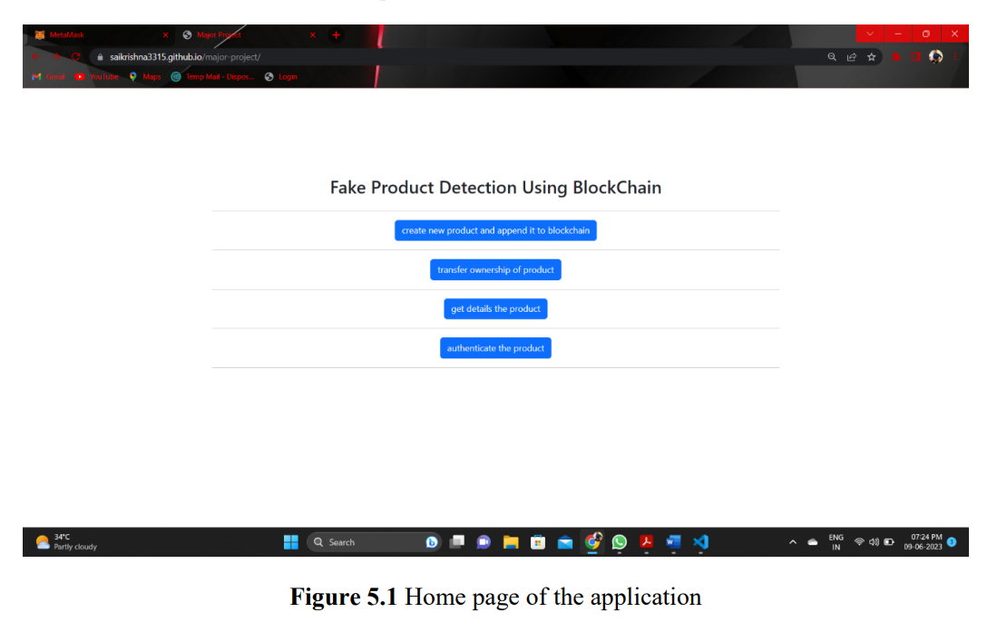
Experiment Screenshots

Slide 10
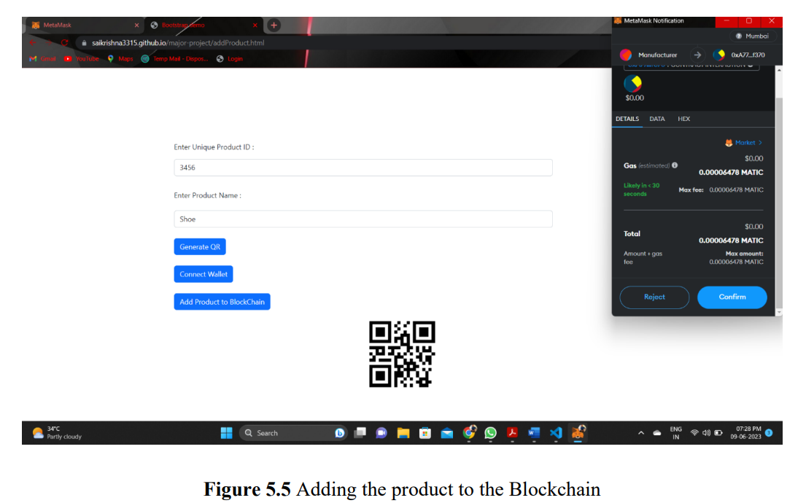
Experiment Screenshots

Slide 11
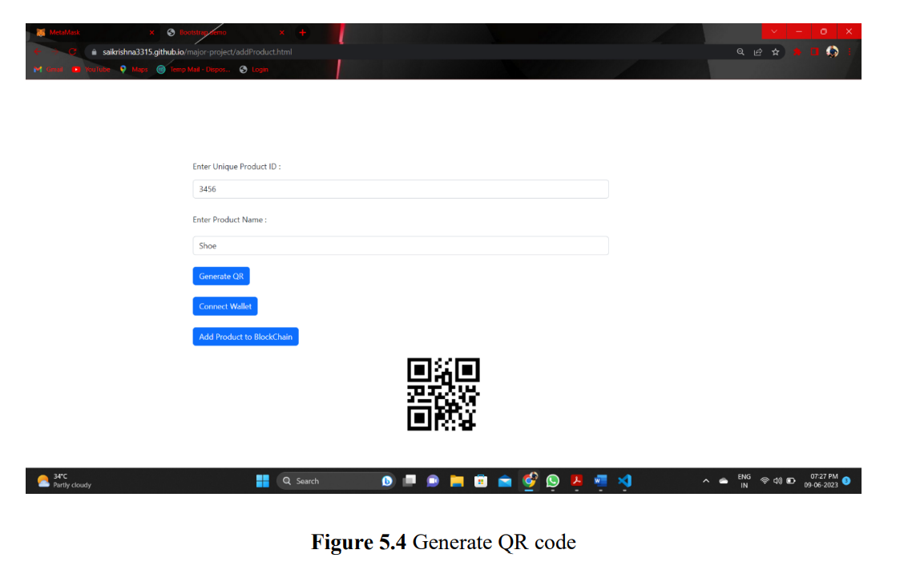
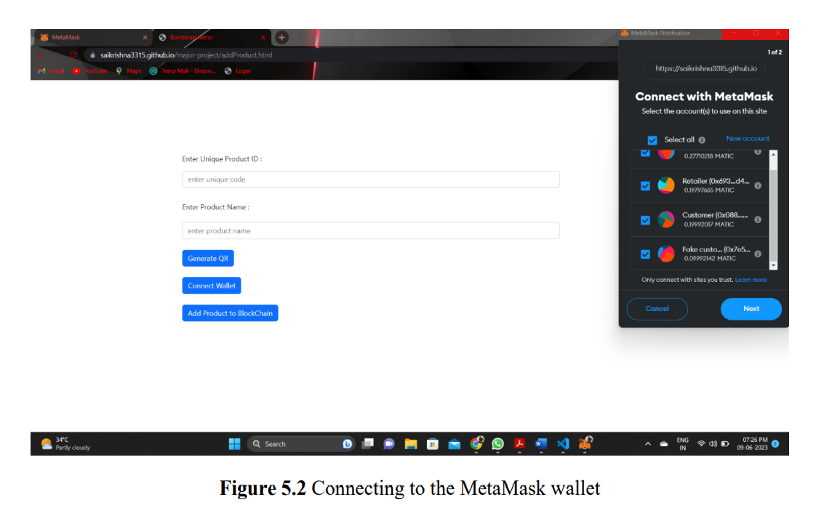
Experiment Screenshots

Slide 12
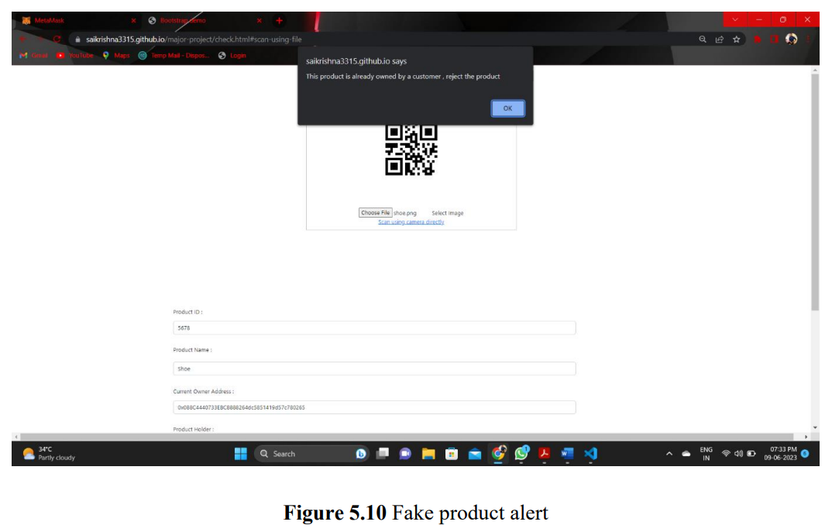
Experiment Results

Slide 13
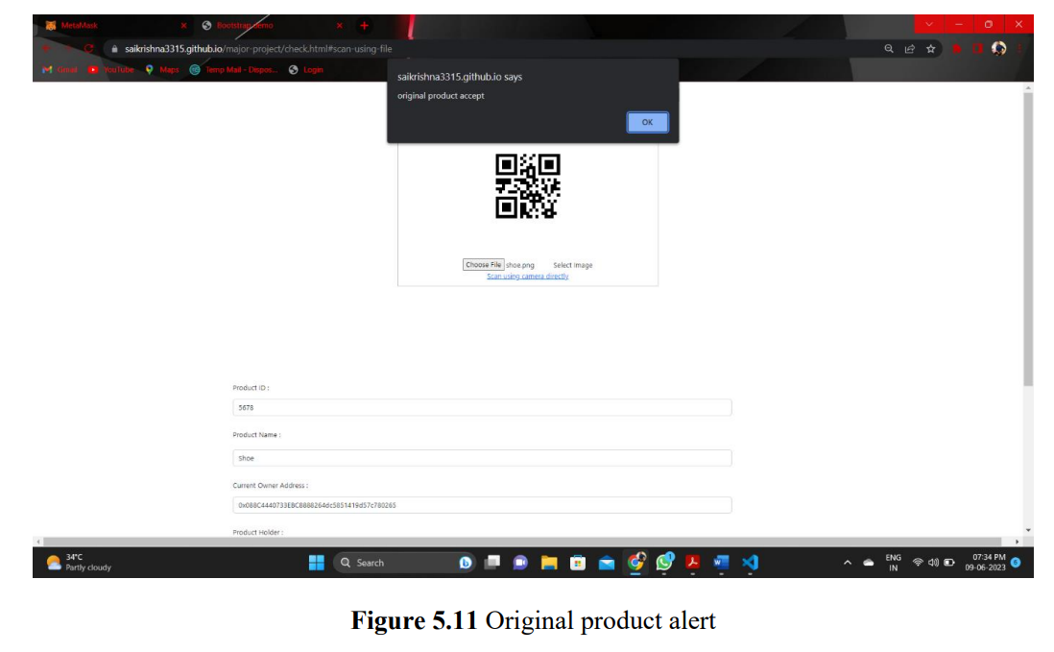
Experiment Results

Slide 14
Findings
After adding the products to the blockchain and using the QR codes for the products . The Increasing in Fake products are decreased rapidly and also now the customers are able to identifying weather the products are genuine are not.
.

Slide 15
Justification
Parameters:
Counterfeit Reduction , QR code Security
Formulas
Reduction % = (Initial Count−Final Count) ×100
Initial Count
In what way the parameters are improved
Counterfeit Reduction : By Adding the products to the Block Chain it will Analyze the similar products easily and produce the Alert message to the Original product Owner.
QR code Security : By using the most secured Algorithm for generating the QR code. Like SHA -256.

